Slide 1
MALLA REDDY UNIVERSITY
MR22-1CS0105: ARTIFICIAL INTELLIGENCE
IiI Year B.Tech. CSE i - Sem
(MR22-1CS0105)
UNIT-I

Slide 2
Introduction: Artificial Intelligence, AI Problems, AI Techniques, the Level of the Model, Criteria for Success.
Defining the Problem as a State Space Search, Problem Characteristics, Production Systems,
Search: Issues in the Design of Search Programs, Un-Informed Search, BFS, and DFS.
Heuristic Search Techniques: Generate-And-Test, Hill Climbing, Best-First Search, A* Algorithm, Problem Reduction, AO* Algorithm.

Slide 3
INTRODUCTION TO ARTIFICIAL INTELLIGENCE
Artificial Intelligence is composed of two words Artificial and Intelligence, where Artificial defines "man-made," and intelligence defines "thinking power", hence AI means "a man-made thinking power.“
"It is a branch of computer science by which we can create intelligent machines which can behave like a human, think like humans, and able to make decisions."

Slide 4
INTRODUCTION TO ARTIFICIAL INTELLIGENCE
Goals of Artificial Intelligence
Replicate human intelligence
Building a machine which can perform tasks that requires human intelligence such as:
Proving a theorem
Playing chess
Plan some surgical operation
Driving a car in traffic
Creating some system which can exhibit intelligent behavior, learn new things by itself, demonstrate, explain, and can advise to its user.

Slide 5
INTRODUCTION TO ARTIFICIAL INTELLIGENCE
Advantages of Artificial Intelligence
High Accuracy with less errors
High-Speed
High reliability
Useful for risky areas
Digital Assistant
Useful as a public utility
Disadvantages of Artificial Intelligence
High Cost
Can't think out of the box
Increase dependency on machines
No Original Creativity

Slide 6
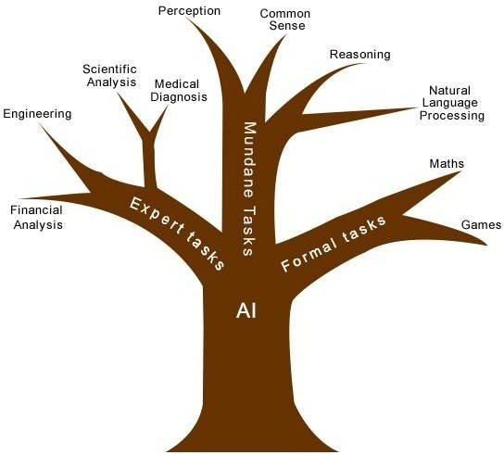
INTRODUCTION TO ARTIFICIAL INTELLIGENCE
ARTIFICIAL INTELLIGENCE PROBLEMS

Slide 7
INTRODUCTION TO ARTIFICIAL INTELLIGENCE
AI TECHNIQUES
These techniques fuel various applications of AI and can be broadly categorized into several areas:
Machine Learning: This is a core AI technique where machines learn from data without being explicitly programmed. It allows them to identify patterns, make predictions, and improve their performance over time. Here are some subcategories of machine learning:
Supervised Learning: Trains models using labeled data (data with known outcomes) for tasks like classification (e.g., spam filtering) and regression (e.g., predicting stock prices).
Unsupervised Learning: Discovers hidden patterns in unlabeled data for tasks like clustering (e.g., grouping customers) and dimensionality reduction (e.g., compressing data for analysis).
Reinforcement Learning: Machines learn through trial and error by interacting with an environment and receiving rewards or penalties. This is useful for training AI agents to play games or control robots.

Slide 8
INTRODUCTION TO ARTIFICIAL INTELLIGENCE
Deep Learning: This is a subfield of machine learning inspired by the structure and function of the human brain. It utilizes artificial neural networks with multiple layers to process complex data like images, text, and speech. Deep learning is a powerful technique for tasks like image recognition, natural language processing, and machine translation.
Natural Language Processing (NLP): This technique equips machines with the ability to understand and process human language. It involves tasks like sentiment analysis (identifying emotions in text), machine translation (converting text from one language to another), and chatbots (conversational AI agents).
Computer Vision: This technique allows computers to interpret and understand visual information from the world. It involves tasks like object detection (identifying objects in images), image recognition (classifying images), and facial recognition (identifying people from their faces).

Slide 9
INTRODUCTION TO ARTIFICIAL INTELLIGENCE
Robotics: This combines AI with mechanical engineering to design and build intelligent robots. AI techniques are used for robot control, navigation, and decision-making, enabling robots to perform tasks autonomously in various environments.
CRITERIA OF SUCCESS
There are several key criteria to consider when evaluating the success of an AI system:
Performance: This is the most fundamental criterion. It measures how well the AI achieves its intended goals.
Accuracy: For tasks like classification (spam filtering) or prediction (stock prices), it refers to how often the AI makes correct decisions.
Efficiency: This measures how quickly the AI can complete a task. This is important for real-time applications where speed is crucial.
Robustness: This refers to how well the AI performs under varying conditions or with unexpected inputs. A robust AI can handle noise, errors, and unforeseen situations.

Slide 10
INTRODUCTION TO ARTIFICIAL INTELLIGENCE
Optimality: This is relevant when the goal is to find the best possible solution, like the shortest path for navigation or the minimum cost in resource allocation. An optimal AI guarantees finding the best solution within the defined constraints.
Learning Ability: As AI systems interact with the world and encounter new data, the ability to learn and improve their performance over time is valuable. This is especially important for tasks where the environment is constantly changing.
Explainability and Transparency: Understanding how an AI system arrives at its decisions is crucial for building trust and ensuring fairness. Ideally, the AI's reasoning process should be transparent and explainable to humans.
Real-World Impact: Ultimately, the success of an AI system is measured by the positive impact it has on the real world. Does it improve efficiency, solve problems, or enhance human capabilities in a meaningful way?

Slide 11
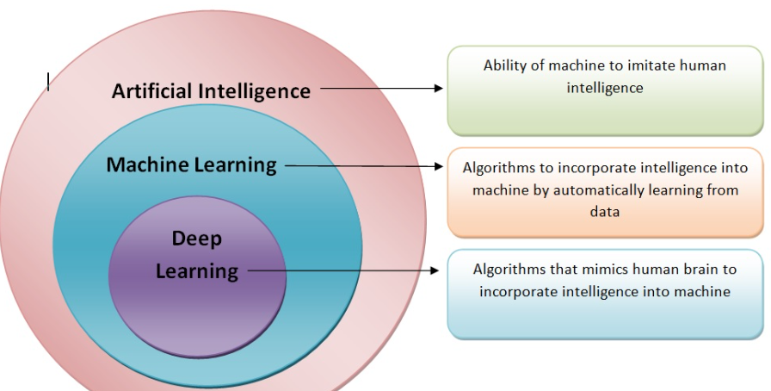
INTRODUCTION TO ARTIFICIAL INTELLIGENCE

Slide 12
INTRODUCTION TO ARTIFICIAL INTELLIGENCE
Defining the problem as State Space Search:
The state space representation forms the basis of most of the AI methods.
Formulate a problem as a state space search by showing the legal problem states, the legal operators, and the initial and goal states.
A state is defined by the specification of the values of all attributes of interest in the world
An operator changes one state into the other; it has a precondition which is the value of certain attributes prior to the application of the operator, and a set of effects, which are the attributes altered by the operator
The initial state is where you start
The goal state is the partial description of the solution

Slide 13
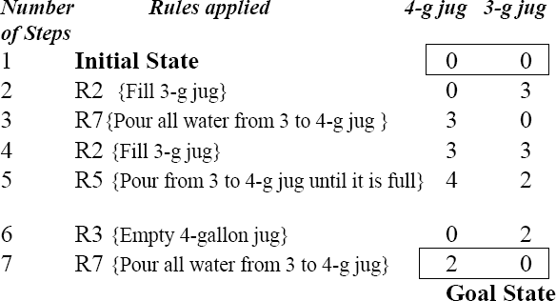
INTRODUCTION TO ARTIFICIAL INTELLIGENCE
Example: Water Jug Problem
Consider the following problem:
A Water Jug Problem: You are given two jugs, a 4-gallon one and a 3-gallon one, a pump which has unlimited water which you can use to fill the jug, and the ground on which water may be poured. Neither jug has any measuring markings on it. How can you get exactly 2 gallons of water in the 4-gallon jug?

Slide 14
INTRODUCTION TO ARTIFICIAL INTELLIGENCE
Problem Characteristics in Artificial Intelligence
Since artificial intelligence (AI) is mainly related to the search process, it is important to have some methodology to choose the best possible solution.
To choose an appropriate method for a particular problem first we need to categorize the problem based on the following characteristics.
Is the problem decomposable into small sub-problems which are easy to solve?
Can solution steps be ignored or undone?
Is the universe of the problem is predictable?

Slide 15
Is a good solution to the problem is absolute or relative?
Is the solution to the problem a state or a path?
What is the role of knowledge in solving a problem using artificial intelligence?
Does the task of solving a problem require human interaction?
1. Is the problem decomposable into small sub-problems which are easy to solve?
Can the problem be broken down into smaller problems to be solved independently?
The decomposable problem can be solved easily.

Slide 16
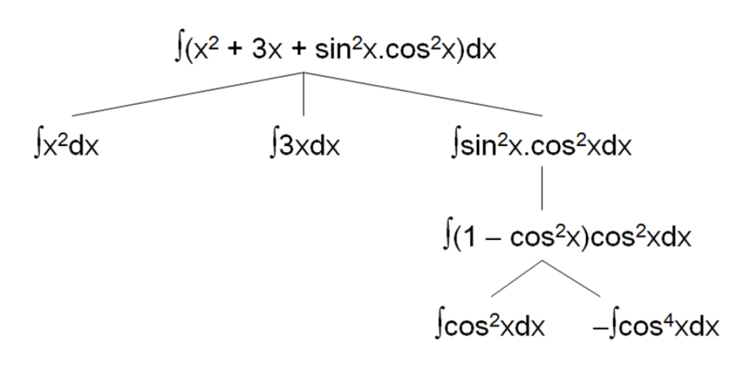
Example: In this case, the problem is divided into smaller problems. The smaller problems are solved independently. Finally, the result is merged to get the final result.

Slide 17
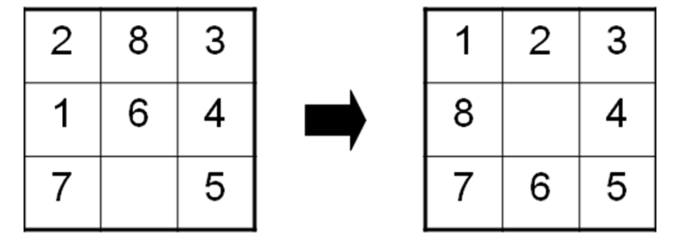
2. Can solution steps be ignored or undone?
In the Theorem Proving problem, a lemma that has been proved can be ignored for the next steps.
Such problems are called Ignorable problems.
In the 8-Puzzle, Moves can be undone and backtracked.
Such problems are called Recoverable problems.

Slide 18
In Playing Chess, moves can be retracted.
Such problems are called Irrecoverable problems.
Ignorable problems can be solved using a simple control structure that never backtracks.
Recoverable problems can be solved using backtracking.
Irrecoverable problems can be solved by recoverable style methods via planning.
3. Is the universe of the problem is predictable?
In Playing Bridge, We cannot know exactly where all the cards are or what the other players will do on their turns.

Slide 19
Uncertain outcome!
For certain-outcome problems, planning can be used to generate a sequence of operators that is guaranteed to lead to a solution.
For uncertain-outcome problems, a sequence of generated operators can only have a good probability of leading to a solution. Plan revision is made as the plan is carried out and the necessary feedback is provided.
4. Is a good solution to the problem is absolute or relative?
The Travelling Salesman Problem, we have to try all paths to find the shortest one.
Any path problem can be solved using heuristics that suggest good paths to explore.
For best-path problems, a much more exhaustive search will be performed.

Slide 20
5. Is the solution to the problem a state or a path
The Water Jug Problem, the path that leads to the goal must be reported.
A path-solution problem can be reformulated as a state-solution problem by describing a state as a partial path to a solution. The question is whether that is natural or not.
6. What is the role of knowledge in solving a problem using artificial intelligence?
Playing Chess
Consider again the problem of playing chess. Suppose you had unlimited computing power available.
How much knowledge would be required by a perfect program?

Slide 21
Additional knowledge about such things as good strategy and tactics could of course help considerably to constrain the search and speed up the execution of the program. Knowledge is important only to constrain the search for a solution.
7. Does the task of solving a problem require human interaction?
we are building programs that require intermediate interaction with people, both to provide additional input to the program and to provide additional reassurance to the user.
The solitary problem, in which there is no intermediate communication and no demand for an explanation of the reasoning process.
The conversational problem, in which intermediate communication is to provide either additional assistance to the computer or additional information to the user.

Slide 22
INTRODUCTION TO ARTIFICIAL INTELLIGENCE
Production System in AI
In artificial intelligence (AI), a production system refers to a type of rule-based system that is designed to provide a structured approach to problem solving and decision-making. This framework is particularly influential in the realm of expert systems, where it simulates human decision-making processes using a set of predefined rules and facts.
Let’s consider an example of Expert System for Medical Diagnosis.
Scenario: A patient comes to a healthcare facility with the following symptoms: fever, severe headache, sensitivity to light, and stiff neck.
Medical diagnosis operates in the following manner:
Input: A healthcare professional inputs the symptoms into MediDiagnose.
Processing:
MediDiagnose reviews its knowledge base for rules that match the given symptoms.
It identifies several potential conditions but recognizes a strong match for meningitis based on the combination of symptoms.
Output:
The system suggests that meningitis could be a possible diagnosis and recommends further tests to confirm, such as a lumbar puncture.
It also provides a list of other less likely conditions based on the symptoms for comprehensive differential diagnosis.

Slide 23
INTRODUCTION TO ARTIFICIAL INTELLIGENCE
Applications of Production Systems
Expert Systems:
Used in domains such as medical diagnosis, financial analysis, and troubleshooting.
Example: MYCIN, an early expert system for medical diagnosis.
Decision Support Systems:
Help make business decisions by evaluating rules against large datasets.
Example: Rule-based systems for credit scoring in financial institutions.
Automated Planning and Scheduling:
Used in robotics, logistics, and operations management to plan and schedule tasks.
Example: STRIPS (Stanford Research Institute Problem Solver), a planning system.

Slide 24
INTRODUCTION TO ARTIFICIAL INTELLIGENCE
Issues in the Design of Search Programs
Designing effective search programs in AI involves addressing several key issues to ensure that they are efficient, scalable, and applicable to a variety of problems. Here are some of the primary challenges:
1. Problem Definition and State Space Representation
Defining the Problem:
A precise definition of the problem, including the initial state, goal state, and the set of possible actions, is crucial for the search program. Ambiguities in problem definition can lead to inefficient searches or incorrect solutions.
State Space Representation:
The way the state space is represented impacts the efficiency of the search. A well-defined state space helps in systematically exploring possible solutions. Complex problems require sophisticated representations to manage the vast number of potential states​ .

Slide 25
INTRODUCTION TO ARTIFICIAL INTELLIGENCE
2. Algorithm Selection and Performance
Choice of Search Algorithm:
Selecting the appropriate search algorithm (e.g., Breadth-First Search, Depth-First Search, A*, Dijkstra's algorithm) is critical. Each algorithm has its own trade-offs in terms of time complexity, space complexity, completeness, and optimality.​
Heuristics:
Informed search algorithms like A* rely on heuristics to guide the search process. Designing effective heuristics that are both admissible and consistent is a significant challenge as they impact the efficiency and accuracy of the search​

Slide 26
INTRODUCTION TO ARTIFICIAL INTELLIGENCE
Uninformed Search Methods:
Breadth- First -Search:
Consider the state space of a problem that takes the form of a tree. Now, if we search the goal along each breadth of the tree, starting from the root and continuing up to the largest depth, we call it breadth first search.
Algorithm:
1. Create a variable called LIST and set it to be the starting state.
2. Loop until a goal state is found or LIST is empty, Do
a. Remove the first element from the LIST and call it E. If the LIST is empty, quit.
b. For every path each rule can match the state E, Do
(i) Apply the rule to generate a new state.
(ii) If the new state is a goal state, quit and return this state.
(iii) Otherwise, add the new state to the end of LIST.

Slide 27
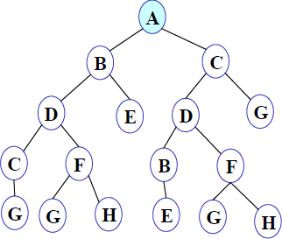
INTRODUCTION TO ARTIFICIAL INTELLIGENCE
BFS illustrated:
Step 1: Initially fringe contains only one node corresponding to the source state A.
FRINGE: A

Slide 28
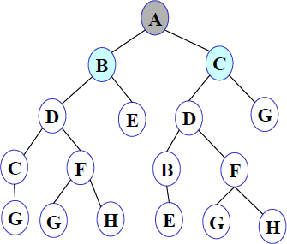
INTRODUCTION TO ARTIFICIAL INTELLIGENCE
Step 2: A is removed from fringe. The node is expanded, and its children B and C are generated. They are placed at the back of fringe.
FRINGE: B C

Slide 29
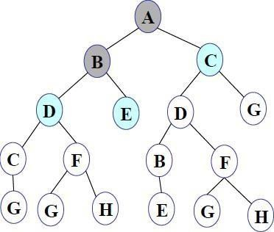
INTRODUCTION TO ARTIFICIAL INTELLIGENCE
Step 3: Node B is removed from fringe and is expanded. Its children D, E are generated and put at the back of fringe.
FRINGE: C D E

Slide 30
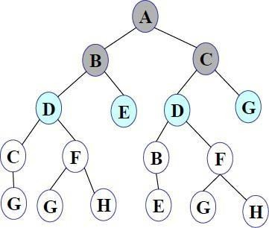
INTRODUCTION TO ARTIFICIAL INTELLIGENCE
Step 4: Node C is removed from fringe and is expanded. Its children D and G are added to the back of fringe.
FRINGE: D E D G

Slide 31
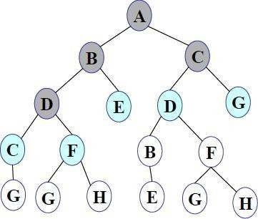
INTRODUCTION TO ARTIFICIAL INTELLIGENCE
Step 5: Node D is removed from fringe. Its children C and F are generated and added to the back of fringe
FRINGE: E D G C F

Slide 32
INTRODUCTION TO ARTIFICIAL INTELLIGENCE
Step 6: Node E is removed from fringe. It has no children.
FRINGE: D G C F

Slide 33
INTRODUCTION TO ARTIFICIAL INTELLIGENCE
Step 7: D is expanded; B and F are put in OPEN.
FRINGE: G C F B F
Step 8: G is selected for expansion. It is found to be a goal node. So the algorithm returns the path A C G by following the parent pointers of the node corresponding to G. The algorithm terminates.

Slide 34
INTRODUCTION TO ARTIFICIAL INTELLIGENCE
Depth- First- Search.
We may sometimes search the goal along the largest depth of the tree, and move up only when further traversal along the depth is not possible. We then attempt to find alternative offspring of the parent of the node (state) last visited. If we visit the nodes of a tree using the above principles to search the goal, the traversal made is called depth first traversal and consequently the search strategy is called depth first search.
Algorithm:
Create a variable called NODE-LIST and set it to initial state
Until a goal state is found or NODE-LIST is empty do
a.Remove the first element from NODE-LIST and call it E. If NODE-LIST was empty, quit
b.For each way that each rule can match the state described in E do:
Apply the rule to generate a new state
If the new state is a goal state, quit and return this state
Otherwise, add the new state in front of NODE-LIST

Slide 35

INTRODUCTION TO ARTIFICIAL INTELLIGENCE
Step 1: Initially fringe contains only the node for A.
FRINGE: A

Slide 36
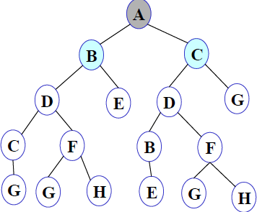
INTRODUCTION TO ARTIFICIAL INTELLIGENCE
Step 2: A is removed from fringe. A is expanded and its children B and C are put in front of fringe.
FRINGE: B C

Slide 37
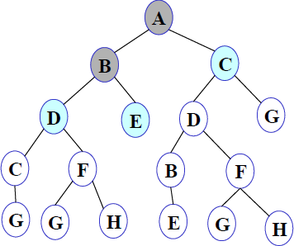
INTRODUCTION TO ARTIFICIAL INTELLIGENCE
Step 3: Node B is removed from fringe, and its children D and E are pushed in front of fringe.
FRINGE: D E C

Slide 38
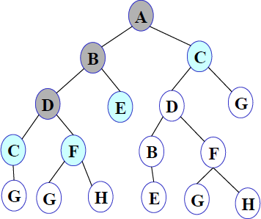
INTRODUCTION TO ARTIFICIAL INTELLIGENCE
Step 4: Node D is removed from fringe. C and F are pushed in front of fringe.
FRINGE: C F E C

Slide 39
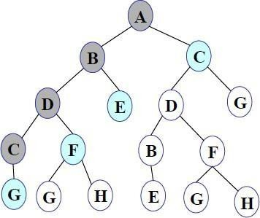
INTRODUCTION TO ARTIFICIAL INTELLIGENCE
Step 5: Node C is removed from fringe. Its child G is pushed in front of fringe.
FRINGE: G F E C

Slide 40
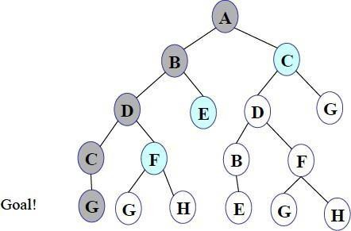
INTRODUCTION TO ARTIFICIAL INTELLIGENCE
Step 6: Node G is expanded and found to be a goal node.
FRINGE: G F E C
The solution path A-B-D-C-G is returned and the algorithm terminates.

Slide 41
A * Algorithm
Search algorithms are algorithms designed to search for or retrieve elements from a data structure, where they are stored.
A vital aspect of search algorithms is Path Finding, which is used to find paths that can be taken to traverse from one point to another, by finding the most optimum route.
We will be dealing with the A* algorithm, which is a search algorithm that finds the shortest path between two points.

Slide 42
What is an A* Algorithm?
It is a searching algorithm that is used to find the shortest path between an initial and a final point.
It is a handy algorithm that is often used for map traversal to find the shortest path to be taken.
A* was initially designed as a graph traversal problem, to help build a robot that can find its own course.
It searches for shorter paths first, thus making it an optimal and complete algorithm.
An optimal algorithm will find the least cost outcome for a problem, while a complete algorithm finds all the possible outcomes of a problem.

Slide 43
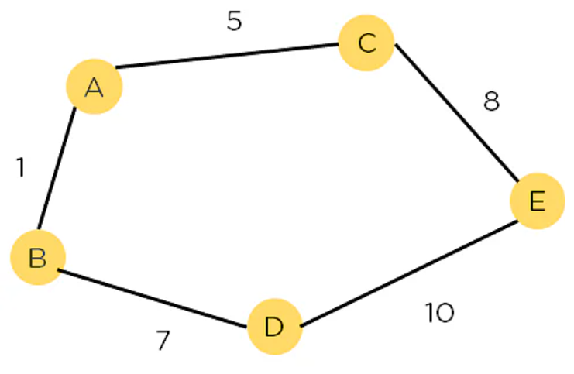
Another aspect that makes A* so powerful is the use of weighted graphs in its implementation.
A weighted graph uses numbers to represent the cost of taking each path or course of action.
This means that the algorithms can take the path with the least cost, and find the best route in terms of distance and time.
A major drawback of the algorithm is its space and time complexity. It takes a large amount of space to store all possible paths and a lot of time to find them.

Slide 44
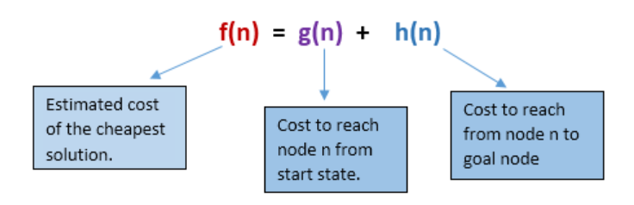
In A* search algorithm, we use search heuristic as well as the cost to reach the node. Hence we can combine both costs as following, and this sum is called as a fitness number.
Algorithm of A* search:
Step1: Place the starting node in the OPEN list.
Step 2: Check if the OPEN list is empty or not, if the list is empty then return failure and stops.
Step 3: Select the node from the OPEN list which has the smallest value of evaluation function (g+h), if node n is goal node then return success and stop,

Slide 45
Step 4: Expand node n and generate all of its successors, and put n into the closed list. For each successor n', check whether n' is already in the OPEN or CLOSED list, if not then compute evaluation function for n' and place into Open list.
Step 5: Else if node n' is already in OPEN and CLOSED, then it should be attached to the back pointer which reflects the lowest g(n') value.
Step 6: Return to Step 2.

Slide 46
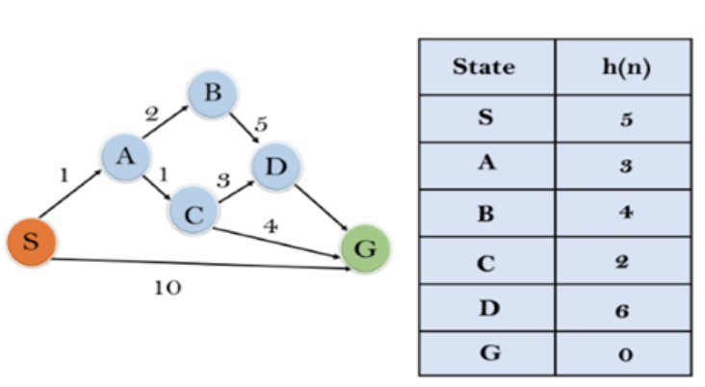
Example:
In this example, we will traverse the given graph using the A* algorithm. The heuristic value of all states is given in the below table so we will calculate the f(n) of each state using the formula f(n)= g(n) + h(n), where g(n) is the cost to reach any node from start state.
Here we will use OPEN and CLOSED list.

Slide 47
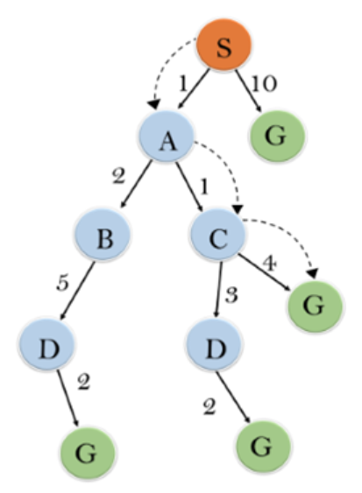
Initialization: {(S, 5)}
Iteration1: {(S--> A, 4), (S-->G, 10)}
Iteration2: {(S--> A-->C, 4), (S--> A-->B, 7), (S-->G, 10)}
Iteration3: {(S--> A-->C--->G, 6), (S--> A-->C--->D, 11),
(S--> A-->B, 7), (S-->G, 10)}
Iteration 4 will give the final result, as S--->A--->C--->G it provides the optimal path with cost 6.

Slide 48
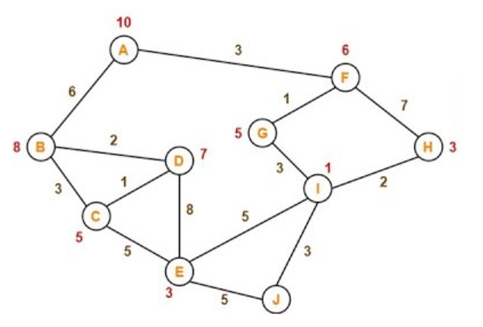
Example 1

Slide 49
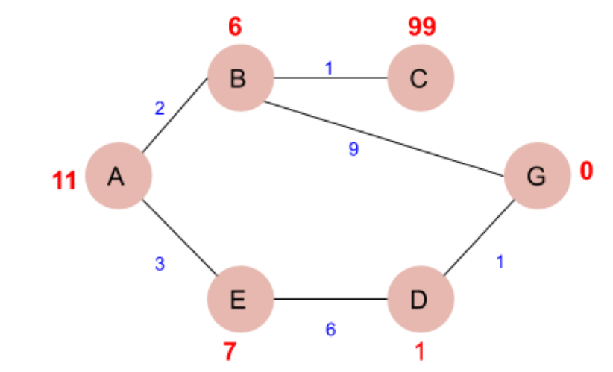
Example: 2
Path found: ['A', 'E', 'D', 'G']

Slide 50
AO * Algorithm
AO* algorithm is a best first search algorithm.
AO* algorithm uses the concept of AND-OR graphs to decompose any complex problem given into smaller set of problems which are further solved.
AND-OR graphs are specialized graphs that are used in problems that can be broken down into sub problems where AND side of the graph represent a set of task that need to be done to achieve the main goal.
whereas the or side of the graph represent the different ways of performing task to achieve the same main goal.

Slide 51
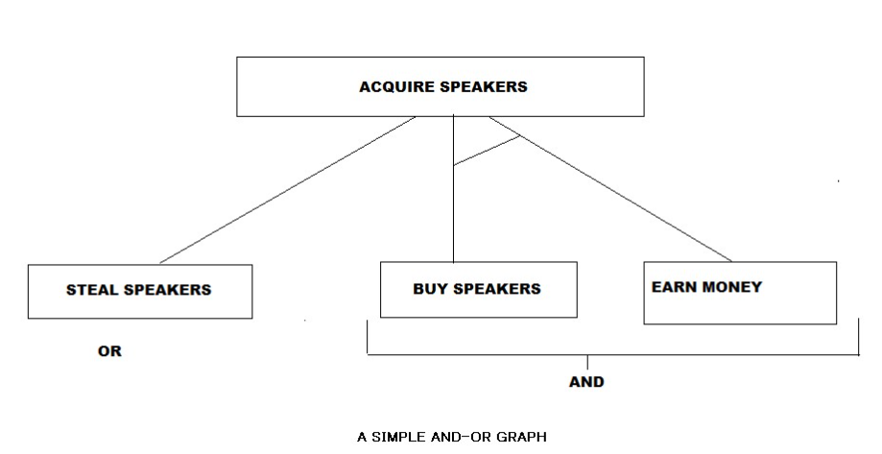
The AND part of the graphs are represented by the AND-ARCS, referring that all the sub problems with the AND-ARCS need to be solved for the predecessor node or problem to be completed.
The edges without AND-ARCS are OR sub problems that can be done instead of the sub problems with And-arcs.

Slide 52
The AO* algorithm is a knowledge-based search technique, meaning the start state and the goal state is already defined , and the best path is found using heuristics.
The time complexity of the algorithm is significantly reduced due to the informed search technique.
Compared to the A* algorithm , AO* algorithm is very efficient in searching the AND-OR trees very efficiently.
Working of AO algorithm:
The AO* algorithm works on the formula given below : f(n) = g(n) + h(n) where,
g(n): The actual cost of traversal from initial state to the current state.
h(n): The estimated cost of traversal from the current state to the goal state.
f(n): The actual cost of traversal from the initial state to the goal state.

Slide 53
Algorithm
Step-1: Create an initial graph with a single node (start node).
Step-2: Transverse the graph following the current path, accumulating node that has not yet been expanded or solved.
Step-3: Select any of these nodes and explore it. If it has no successors then call this value- FUTILITY else calculate f'(n) for each of the successors.
Step-4: If f'(n)=0, then mark the node as SOLVED.
Step-5: Change the value of f'(n) for the newly created node to reflect its successors by back propagation.
Step-6: Whenever possible use the most promising routes, If a node is marked as SOLVED then mark the parent node as SOLVED.
Step-7: If the starting node is SOLVED or value is greater than FUTILITY then stop else repeat from Step-2.

Slide 54
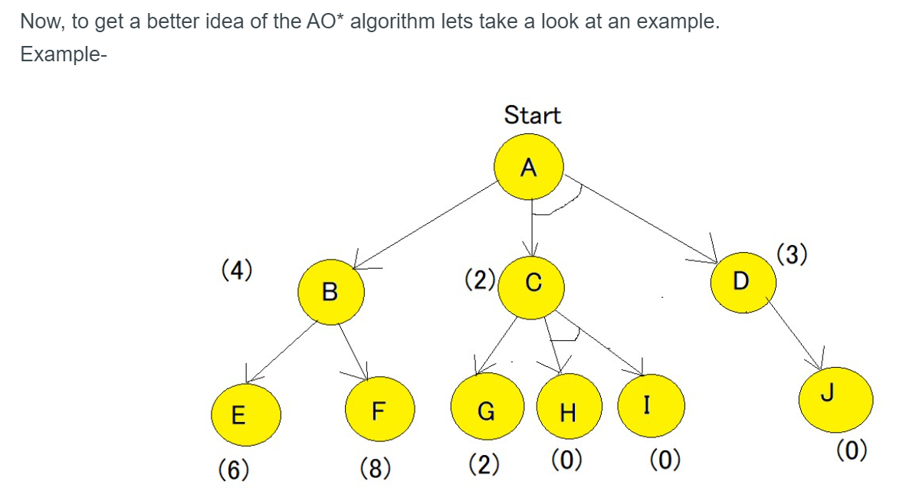

Slide 55
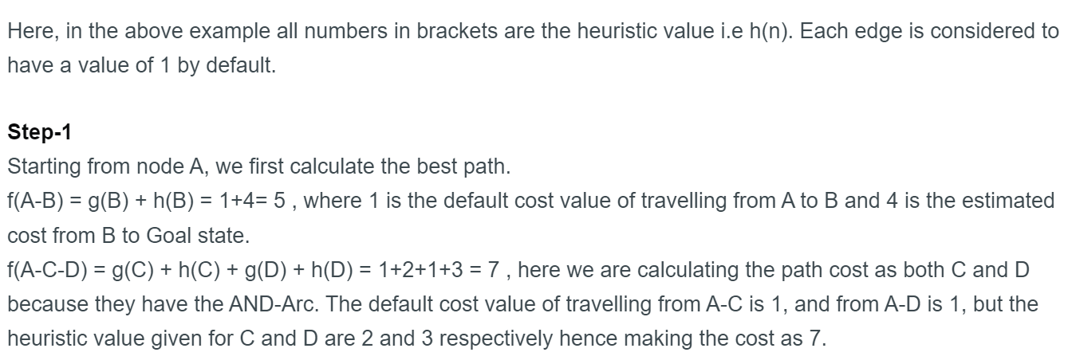

Slide 56
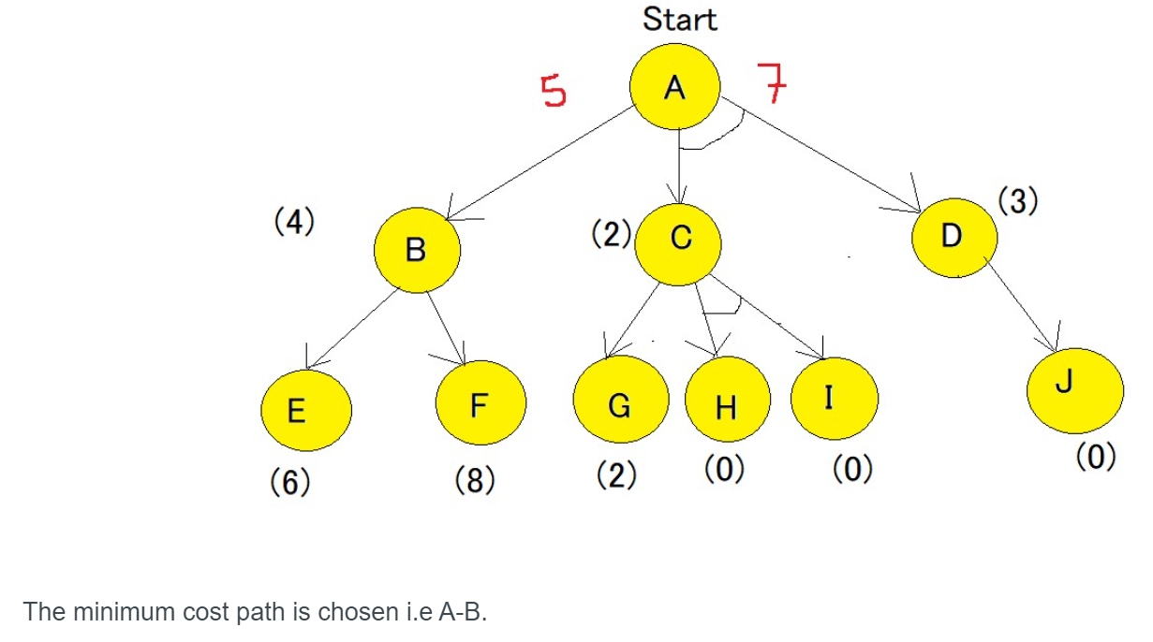

Slide 57
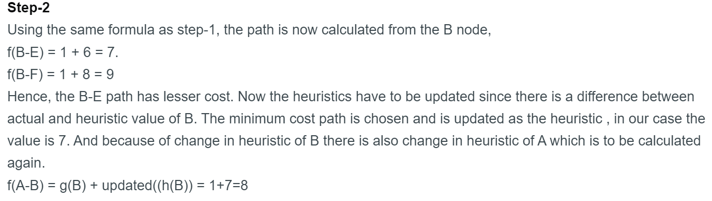

Slide 58
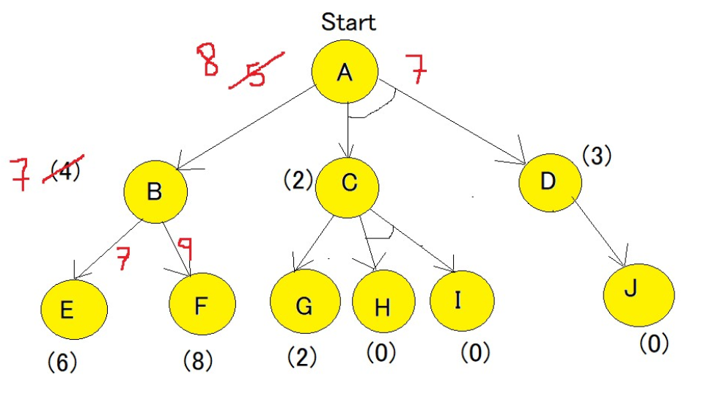

Slide 59
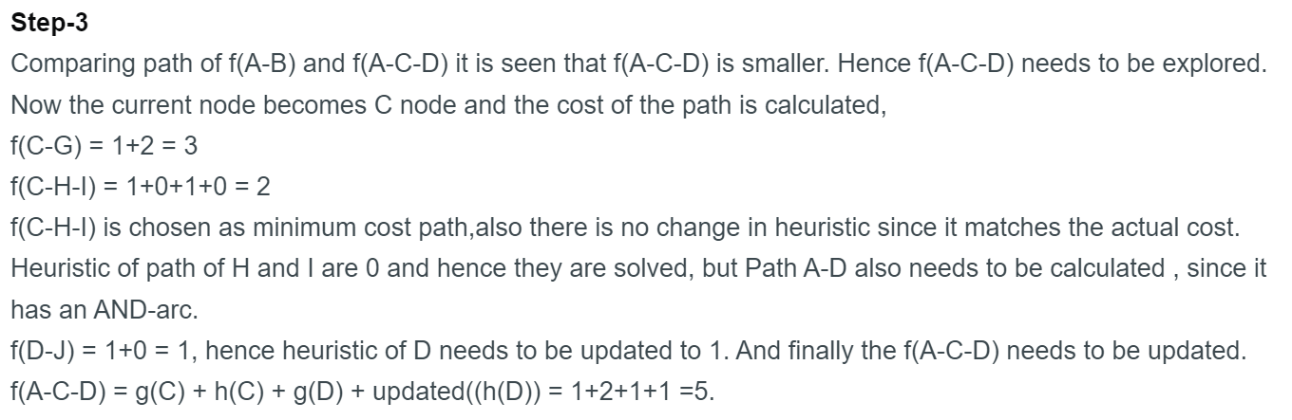

Slide 60
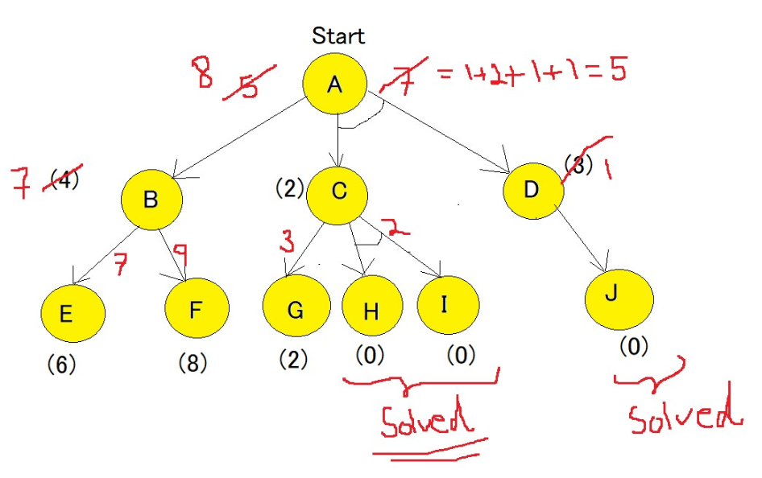


Slide 61
The difference between A* Algorithm and AO* algorithm?
A* algorithm provides with the optimal solution, whereas AO* stops when it finds any solution.
AO* algorithm requires lesser memory compared to A* algorithm.
AO* algorithm doesn't go into infinite loop whereas the A* algorithm can go into an infinite loop.

Slide 62
Best First Search
If we consider searching as a form of traversal in a graph, an uninformed search algorithm would blindly traverse to the next node in a given manner without considering the cost associated with that step.
An informed search, like BFS, on the other hand, would use an evaluation function to decide which among the various available nodes is the most promising (or ‘BEST’) before traversing to that node.
BFS uses the concept of a Priority queue and heuristic search. To search the graph space, the BFS method uses two lists for tracking the traversal.

Slide 63
An ‘Open’ list that keeps track of the current ‘immediate’ nodes available for traversal and a ‘CLOSED’ list that keeps track of the nodes already traversed.
Best First Search Algorithm
Step 1 : Create a priorityQueue pqueue.
Step 2 : insert ‘start’ in pqueue : pqueue.insert(start)
Step 3 : delete all elements of pqueue one by one.
Step 3.1 : if, the element is goal . Exit.
Step 3.2 : else, traverse neighbours and mark the node examined.
Step 4 : End.

Slide 64
This algorithm will traverse the shortest path first in the queue. The time complexity of the algorithm is given by O(n*logn).
The idea of Best First Search is to use an evaluation function to decide which adjacent is most promising and then explore.
We use a priority queue or heap to store the costs of nodes that have the lowest evaluation function value. So the implementation is a variation of BFS, we just need to change Queue to PriorityQueue.

Slide 65
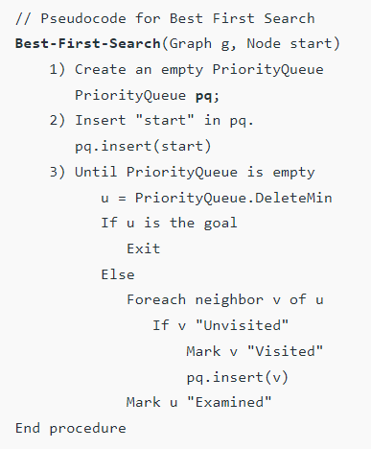

Slide 66
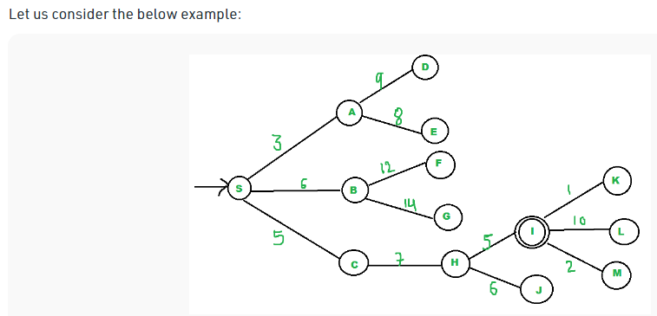
We start from source “S” and search for goal “I” using given costs and Best First search.
pq initially contains S
We remove s from and process unvisited neighbors of S to pq.
pq now contains {A, C, B} (C is put before B because C has lesser cost)

Slide 67
We remove A from pq and process unvisited neighbors of A to pq.
pq now contains {C, B, E, D}
We remove C from pq and process unvisited neighbors of C to pq.
pq now contains {B, H, E, D}
We remove B from pq and process unvisited neighbors of B to pq.
pq now contains {H, E, D, F, G}
We remove H from pq.
Since our goal “I” is a neighbor of H, we return.

Slide 68
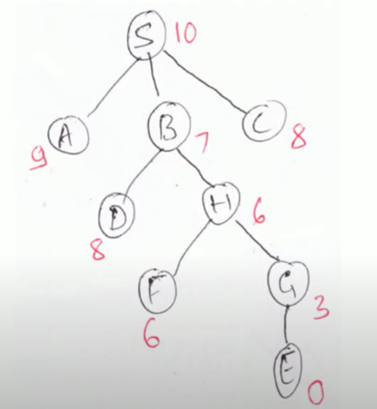

Slide 69
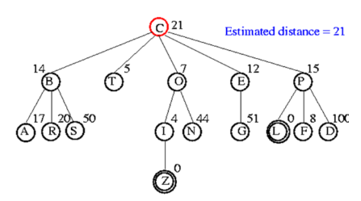

Slide 70
Introduction to Hill Climbing
Hill Climbing is a heuristic search used for mathematical optimization problems in the field of Artificial Intelligence.
Given a large set of inputs and a good heuristic function, it tries to find a sufficiently good solution to the problem.
This solution may not be the global optimal maximum
In the above definition, mathematical optimization problems imply that hill-climbing solves the problems where we need to maximize or minimize a given real function by choosing values from the given inputs.
Example-Travelling salesman problem where we need to minimize the distance traveled by the salesman.

Slide 71
‘Heuristic search’ means that this search algorithm may not find the optimal solution to the problem. However, it will give a good solution in a reasonable time.
A heuristic function is a function that will rank all the possible alternatives at any branching step in the search algorithm based on the available information.
It helps the algorithm to select the best route out of possible routes.

Slide 72
Hill Climbing Algorithm
Hill climbing algorithm is a local search algorithm which continuously moves in the direction of increasing elevation/value to find the peak of the mountain or best solution to the problem.
Hill climbing algorithm is a technique which is used for optimizing the mathematical problems.
It is also called greedy local search as it only looks to its good immediate neighbor state and not beyond that.
A node of hill climbing algorithm has two components which are state and value.
Hill Climbing is mostly used when a good heuristic is available.
In this algorithm, we don't need to maintain and handle the search tree or graph as it only keeps a single current state

Slide 73
Features of Hill Climbing:
Following are some main features of Hill Climbing Algorithm:
Generate and Test variant: Hill Climbing is the variant of Generate and Test method. The Generate and Test method produce feedback which helps to decide which direction to move in the search space.
Greedy approach: Hill-climbing algorithm search moves in the direction which optimizes the cost.
No backtracking: It does not backtrack the search space, as it does not remember the previous states.

Slide 74
State-space Diagram for Hill Climbing:
The state-space landscape is a graphical representation of the hill-climbing algorithm.
On Y-axis we have taken the function which can be an objective function or cost function, and state-space on the x-axis.
If the function on Y-axis is cost then, the goal of search is to find the global minimum and local minimum.
If the function of Y-axis is Objective function, then the goal of the search is to find the global maximum and local maximum.

Slide 75
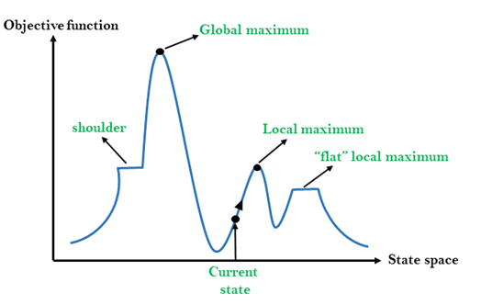
Local Maximum: Local maximum is a state which is better than its neighbor states, but there is also another state which is higher than it.
Global Maximum: Global maximum is the best possible state of state space landscape. It has the highest value of objective function.
Current state: It is a state in a landscape diagram where an agent is currently present.
Flat local maximum: It is a flat space in the landscape where all the neighbor states of current states have the same value.
Shoulder: It is a plateau region which has an uphill edge.

Slide 76
Types of Hill Climbing Algorithm:
Simple hill Climbing:
Steepest-Ascent hill-climbing:
Stochastic hill Climbing:
1. Simple Hill Climbing:
Simple hill climbing is the simplest way to implement a hill climbing algorithm.
It only evaluates the neighbor node state at a time and selects the first one which optimizes current cost and set it as a current state.
It only checks it's one successor state, and if it finds better than the current state, then move else be in the same state. This algorithm has the following features:
Less time consuming
Less optimal solution and the solution is not guaranteed

Slide 77
Algorithm for Simple Hill Climbing:
Step 1: Evaluate the initial state, if it is goal state then return success and Stop.
Step 2: Loop Until a solution is found or there is no new operator left to apply.
Step 3: Select and apply an operator to the current state.
Step 4: Check new state:
If it is goal state, then return success and quit.
Else if it is better than the current state then assign new state as a current state.
Else if not better than the current state, then return to step2.
Step 5: Exit.

Slide 78
2. Steepest-Ascent hill climbing:
The steepest-Ascent algorithm is a variation of simple hill climbing algorithm.
This algorithm examines all the neighboring nodes of the current state and selects one neighbor node which is closest to the goal state.
This algorithm consumes more time as it searches for multiple neighbors
Algorithm for Steepest-Ascent hill climbing:
Step 1: Evaluate the initial state, if it is goal state then return success and stop, else make current state as initial state.
Step 2: Loop until a solution is found or the current state does not change.

Slide 79
Let SUCC be a state such that any successor of the current state will be better than it.
For each operator that applies to the current state:
Apply the new operator and generate a new state.
Evaluate the new state.
If it is goal state, then return it and quit, else compare it to the SUCC.
If it is better than SUCC, then set new state as SUCC.
If the SUCC is better than the current state, then set current state to SUCC.
Step 5: Exit.

Slide 80
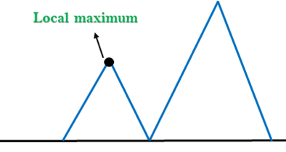
3. Stochastic hill climbing:
Stochastic hill climbing does not examine for all its neighbor before moving. Rather, this search algorithm selects one neighbor node at random and decides whether to choose it as a current state or examine another state.
Problems in Hill Climbing Algorithm:
Local Maximum: A local maximum is a peak state in the landscape which is better than each of its neighboring states, but there is another state also present which is higher than the local maximum.

Slide 81
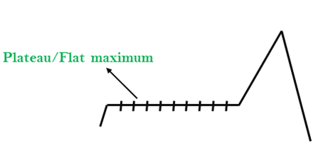
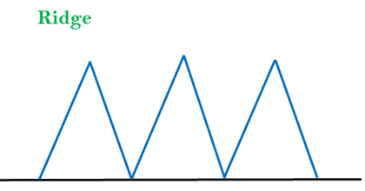
Plateau: A plateau is the flat area of the search space in which all the neighbor states of the current state contains the same value. A hill-climbing search might be lost in the plateau area.
Ridges: A ridge is a special form of the local maximum. It has an area which is higher than its surrounding areas, but itself has a slope, and cannot be reached in a single move.

Slide 82
